Slide 1

10 Telemetry Tips
That Will Boost Your Dynamics 365 Business Central Troubleshooting

Slide 2


whoami
In the ERP business since 1998
COMPETITOR : ERP Software Developer with a local ERP (6Y)
CUSTOMER : Dynamics NAV System Administrator (4Y)
MICROSOFT : Escalation Engineer Dynamics NAV / 365 Business Central (15Y)
PARTNER : Performance Specialist @ EOS Solutions Group
MCT and Books Author
52 years old
Married with 2 kids
https://duiliotacconi.com/

Slide 3
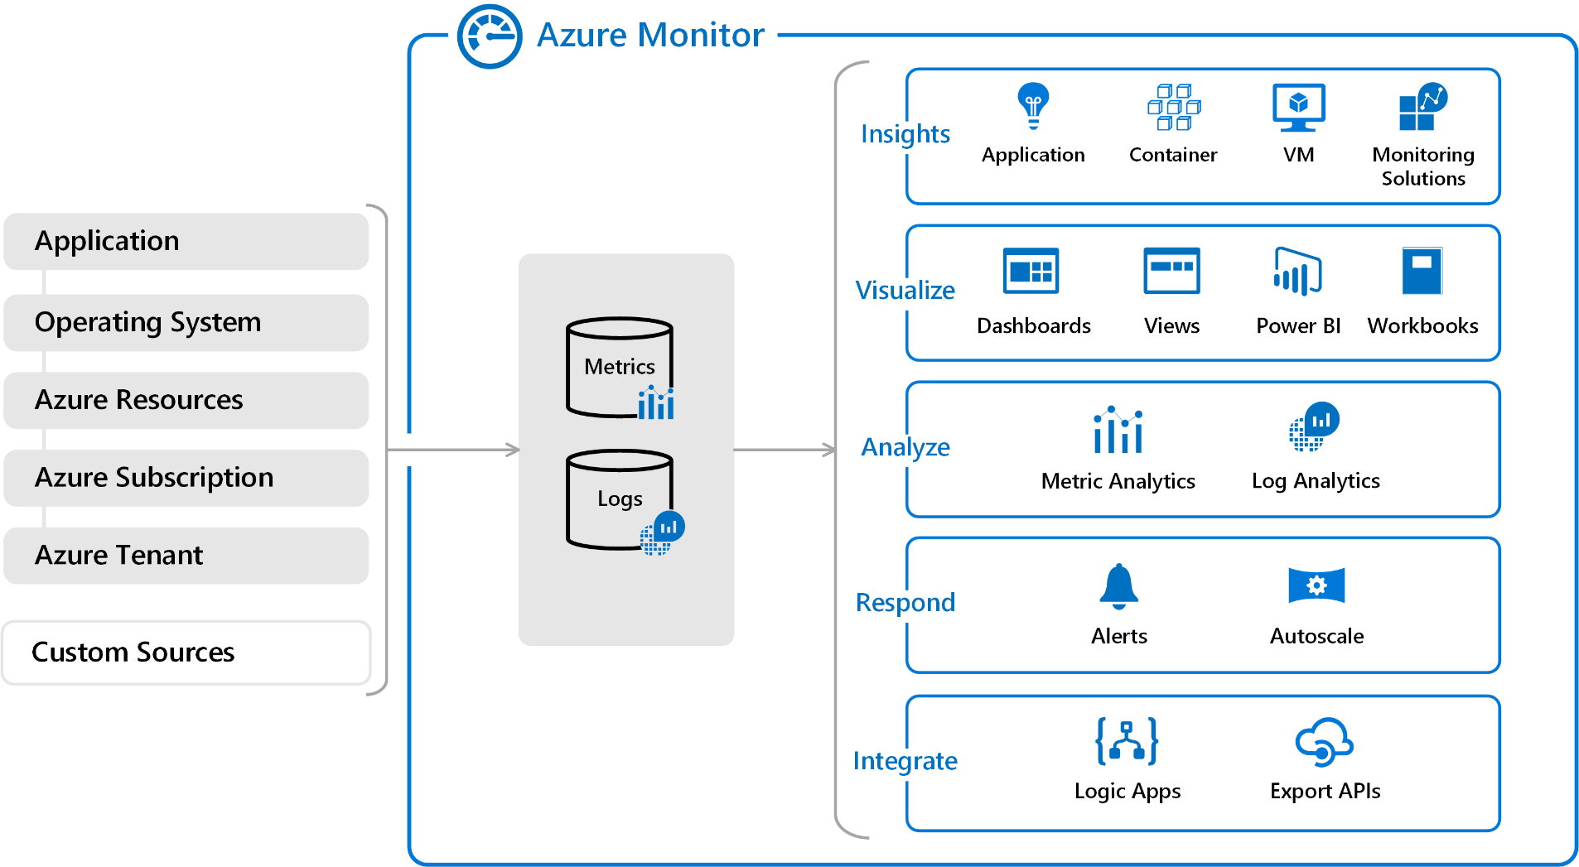
Let’s go straight to the point
GOALS
OBSERVABILITY
TROUBLESHOOTING

Slide 4

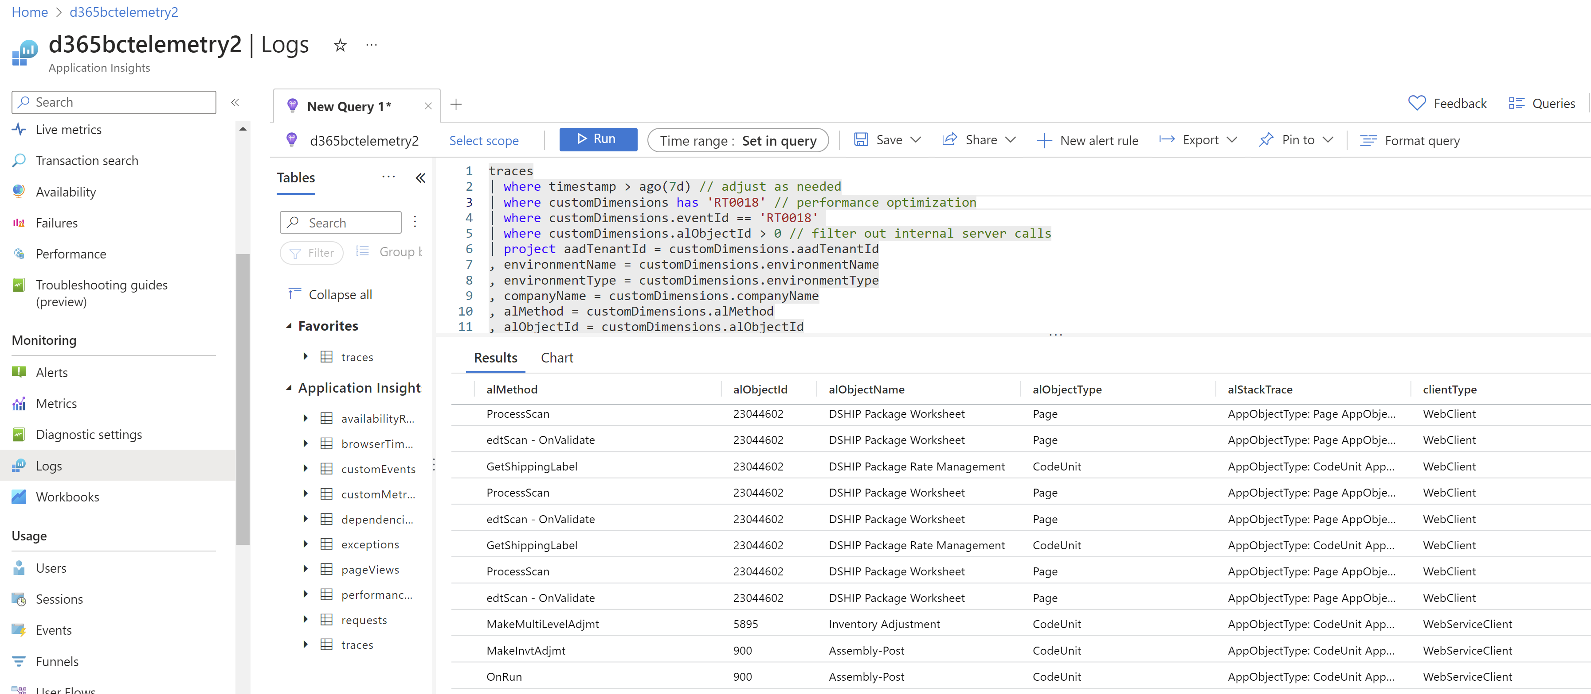
1. Choose The Right Tool

Slide 5

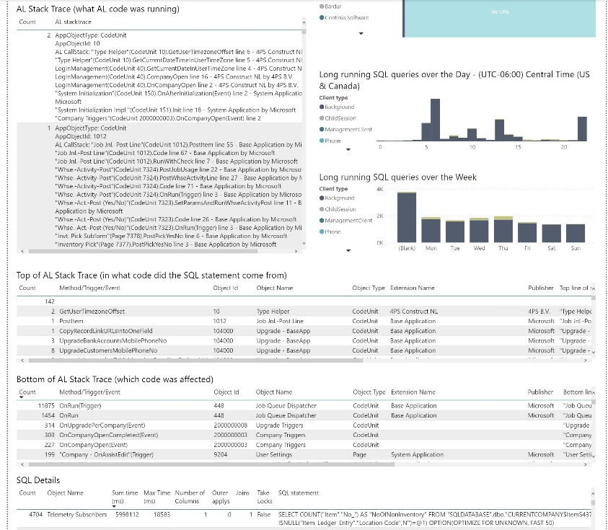
1. Choose The Right Tool

Slide 6

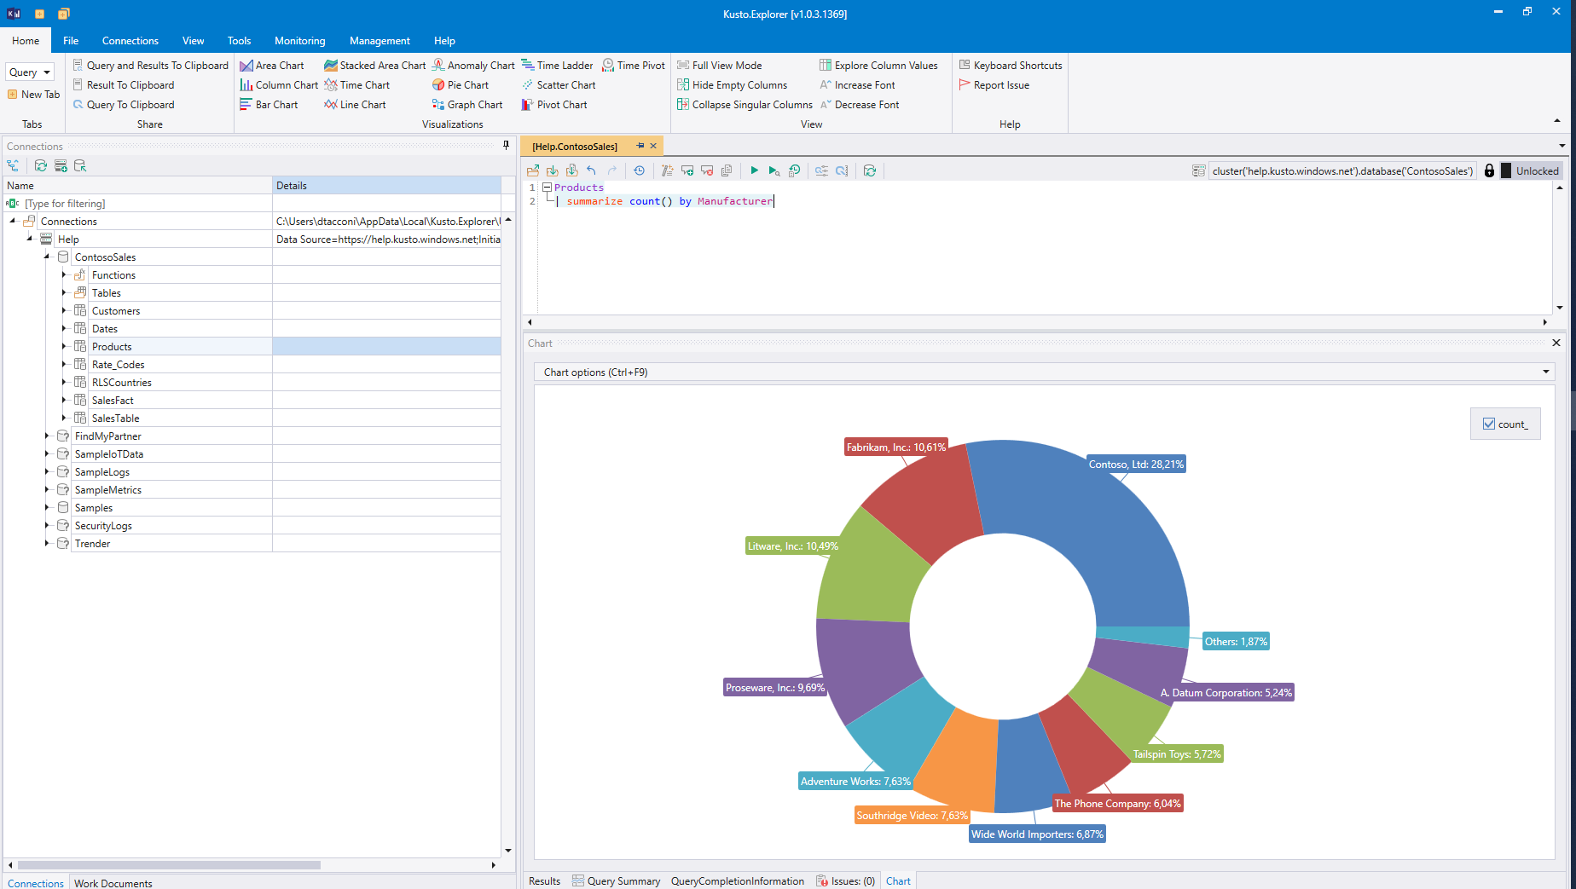
1. Choose The Right Tool

Slide 7

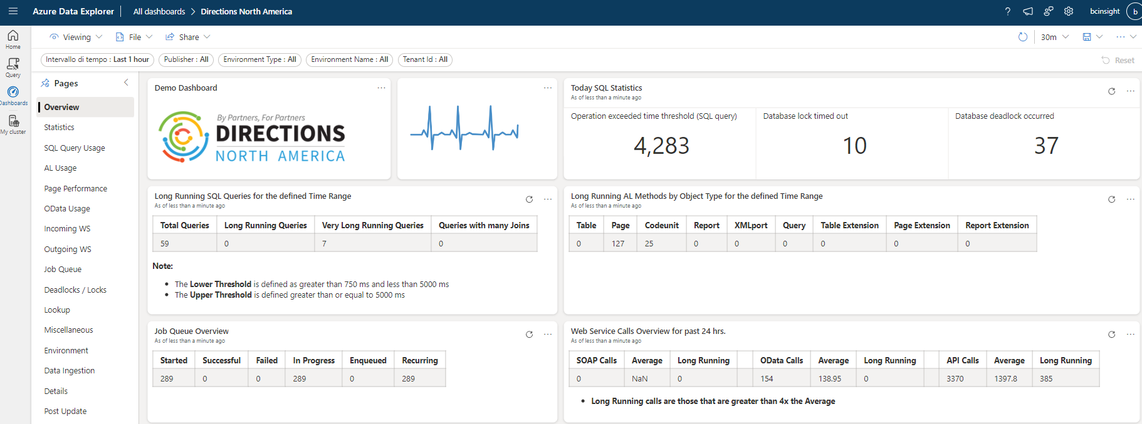
1. Choose The Right Tool

Slide 8
1. Choose The Right Tool
Log Analytics
Spot analysis. Only if you have no other tools available.
Power BI
BEST for Data Visualization
Created and maintained by Microsoft
Needs a Power BI license
Not so good for JIT troubleshooting (as of now)
Azure Data Explorer (ADE)
BEST for JIT Troubleshooting
No extra cost
Dashboards
Less data visualization capabilities than Power BI (e.g. no sparklines, as of now)
Kusto Explorer
GOOD for JIT troubleshooting
No extra cost
No dashboards

Slide 9
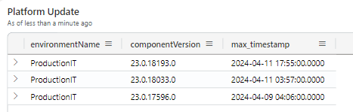
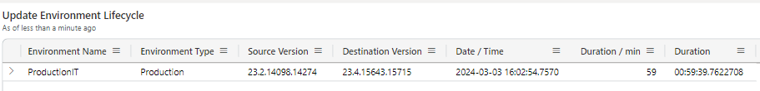
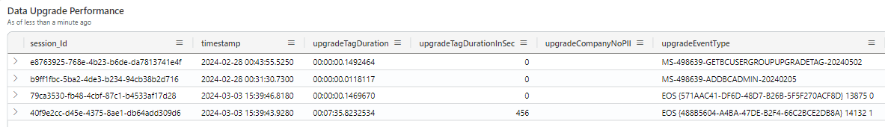
2. Use environmental signals as first stop
Environmental signals : https://learn.microsoft.com/en-us/dynamics365/business-central/dev-itpro/administration/telemetry-environment-lifecycle-trace (available since v20.0)

Slide 10
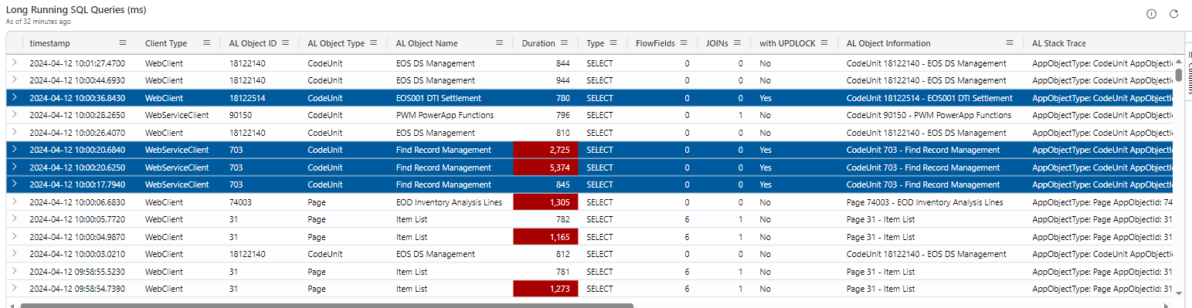
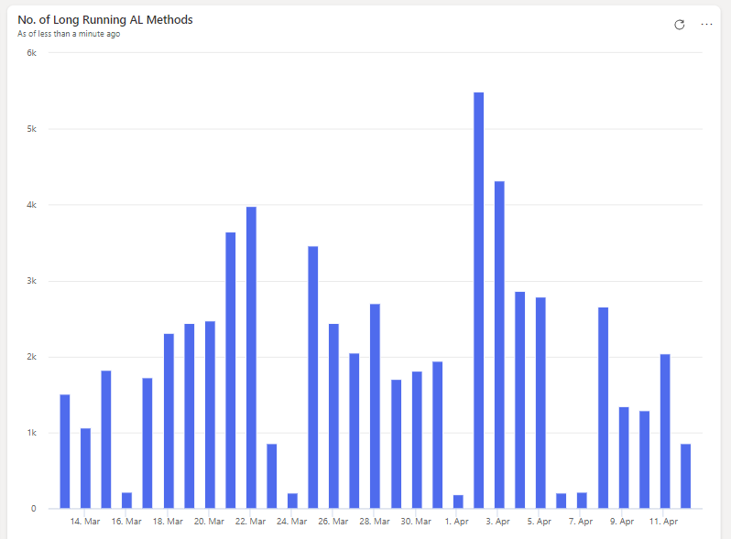
3. Check Long Running SQL Queries (LRQ) / AL Methods(LRAM)
Long Running SQL Queries (LRQ) RT0005 : https://learn.microsoft.com/en-us/dynamics365/business-central/dev-itpro/administration/telemetry-long-running-sql-query-trace (available since v15.0)
Long Running AL Methods (LRAM) RT0018 : https://learn.microsoft.com/en-us/dynamics365/business-central/dev-itpro/administration/telemetry-environment-lifecycle-trace (available since 17.1)

Slide 11
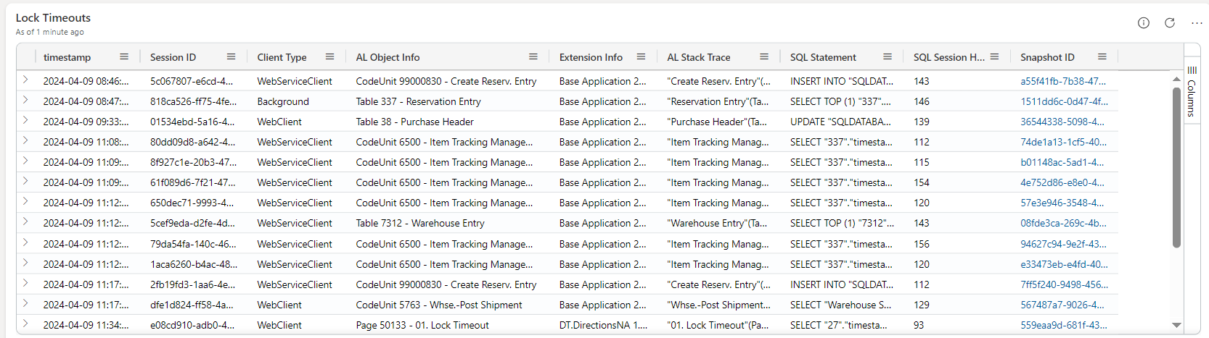

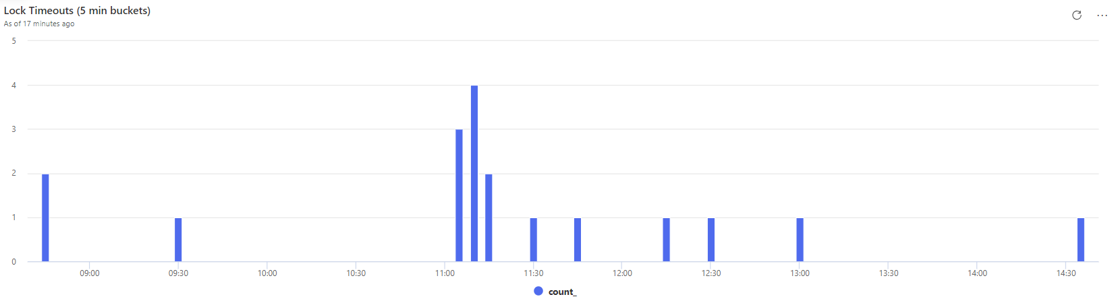
4. Investigate Lock Timeouts
Lock Timeouts (RT0012 / RT0013): https://learn.microsoft.com/en-us/dynamics365/business-central/dev-itpro/administration/telemetry-database-locks-trace (available since v16.2)

Slide 12
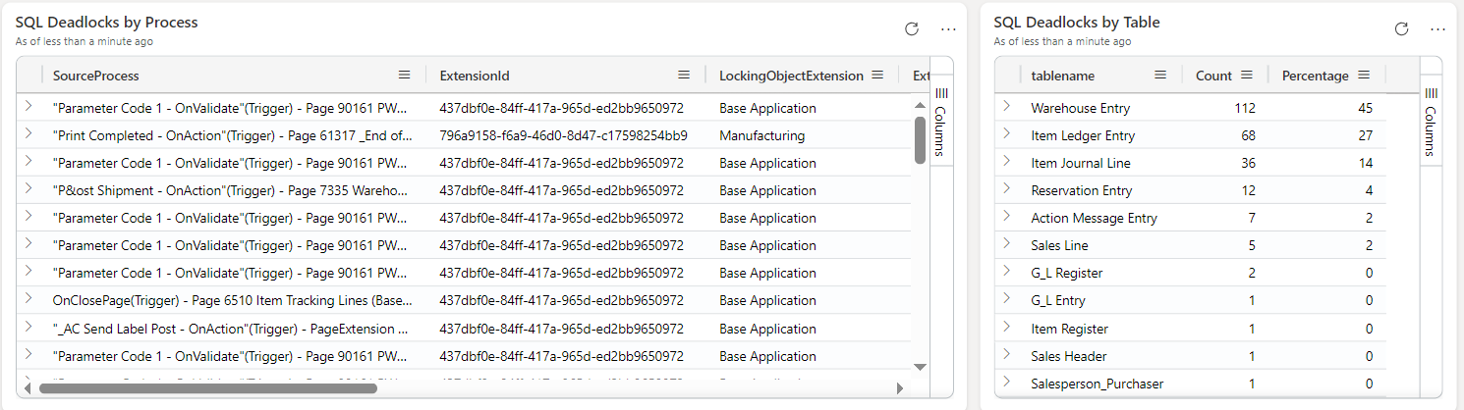
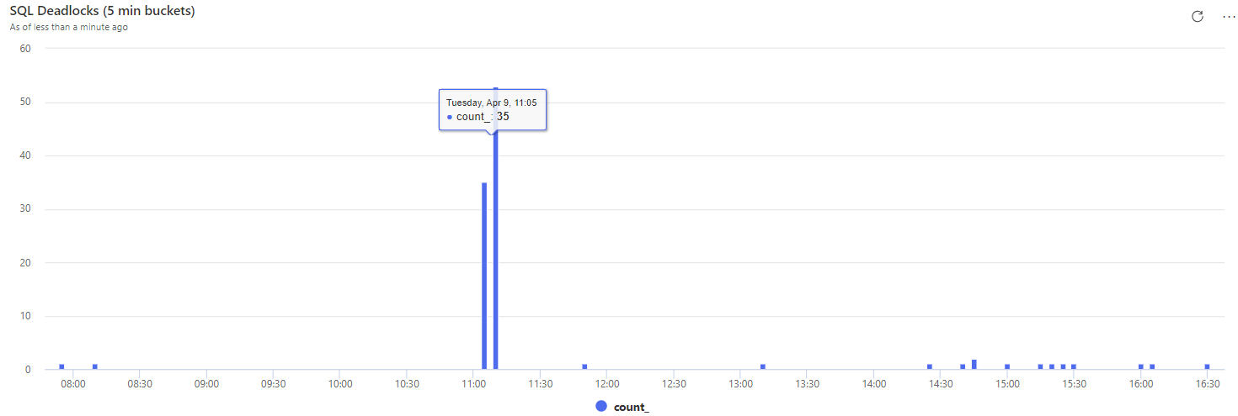
5. Investigate Deadlocks
Environmental signals (RT0028) : https://learn.microsoft.com/en-us/dynamics365/business-central/dev-itpro/administration/telemetry-environment-lifecycle-trace (available since v20.0)

Slide 13
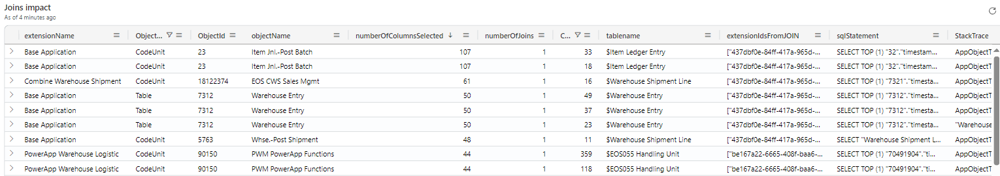
6. Improvement patterns: Setloadfields
Setloadfields: https://learn.microsoft.com/en-us/dynamics365/business-central/dev-itpro/developer/devenv-partial-records

Slide 14
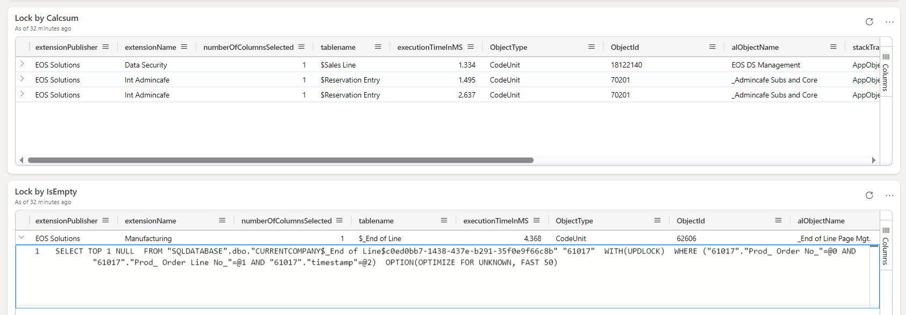

7. Improvement patterns: ReadIsolation
ReadIsolation (available since v21.0) : https://learn.microsoft.com/en-us/dynamics365/business-central/dev-itpro/developer/devenv-read-isolation
Milestone Video https://www.youtube.com/watch?v=1Ln98czYXmo&t=1911s

Slide 15
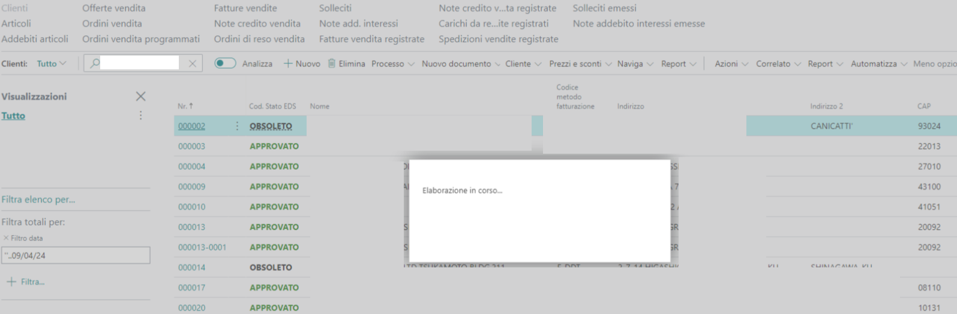

8. Determine What Was Running at that time
Assumption: many signals have executionTime, totalTime, serverExecutionTime. You have to determine WHEN they started.
Example: Tuesday 9th April between 18:42 to 18:44 UTC+2

Slide 16
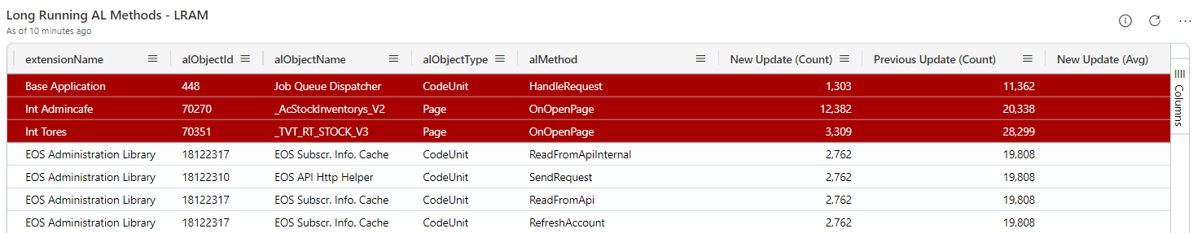
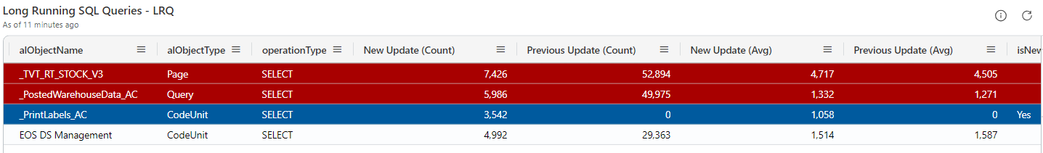
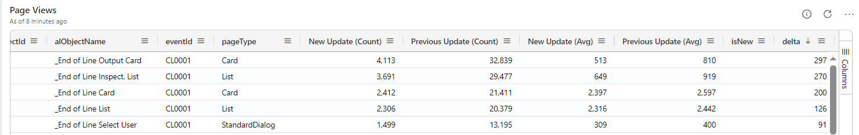
9. Compare pre- and post- update / changes
After major update
After minor update
After AppSource apps changes
After Per Tenant Extension updates

Slide 17
10. Useful KQL
CHEAT SHEET
Official CS: KQL cheat sheets - Quick Reference official page - Microsoft Community Hub
MS Learn: KQL quick reference - Azure Data Explorer & Real-Time Analytics | Microsoft Learn
Boost your KQL scripts with:
evaluate pivot
hourofday
externaldata

Slide 18
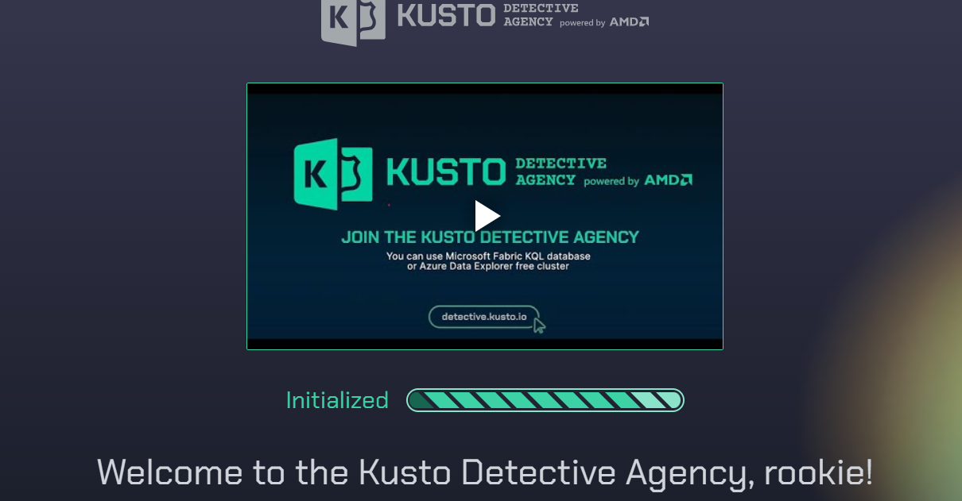
BONUS TRACK : Start / Continue learning KQL
BEGINNERS
MS Learn (course) : Data analysis with Kusto Query Language - Training | Microsoft Learn
MS Learn: Kusto Query Language (KQL) overview - Azure Data Explorer & Real-Time Analytics | Microsoft Learn
Pluralshight : KQL Online Course: The Basics of Kusto Query Language | Pluralsight
Free E-book : GitHub - rod-trent/MustLearnKQL: Code included as part of the MustLearnKQL blog series
ADVANCED (and Learn while having fun)
Kusto Detective Agency : Kusto Detective Agency

Slide 19
10 Telemetry Tips : Recap
Choose the right tool (PowerBI vs ADE)
Signals: Environmental signals as first train stop
Signals: Long running queries / AL methods (RT0005, RT0018)
Signals: Lock Timeout (RT0012 / RT0013)
Signals: Deadlock (RT0023)
Potential Setloadfields pattern (SQL queries with Join(s) / many fields)
Potential ReadIsolation pattern (Typically IsEmpty / Calcsums)
Combine signals to know What Was Running in that specific time
Compare pre- and post- signals frequency and average time
3 KQL boosters: evaluate pivot, hourofday, externaldata
BONUS TRACK : KQL learning paths – from zero to hero

Slide 20

Thank You!

